Slide 1
Warehouse Management
Class Name: PF1126
Group Name: Vu Minh Long
Member: Vu Quang Minh
Phan Canh Long Vu
Nguyen Gia Long

Slide 2
Objectives
Increase Warehouse Management Efficiency
Accurate Inventory Data
Improve Inventory Processes
Enhance Traceability and Reporting
Improve Order Management
Improve Security and Decentralization

Slide 3
Introduction to Project
Warehouse Management System is designed to support efficient management of import and export processes and inventory of finished products.
This system helping to optimize warehouse management processes, from inventory tracking, supplier management, to product distribution and processing of input/output requests.
The system provides solutions to improve management efficiency, ensure accurate and relevant data, and support management based on detailed reports.

Slide 4
Customer Requirements
User management
Supplier management
Warehouse management
Product management
Stock management
Inbound/Outbound/Transfer management
Inventory Audit

Slide 5
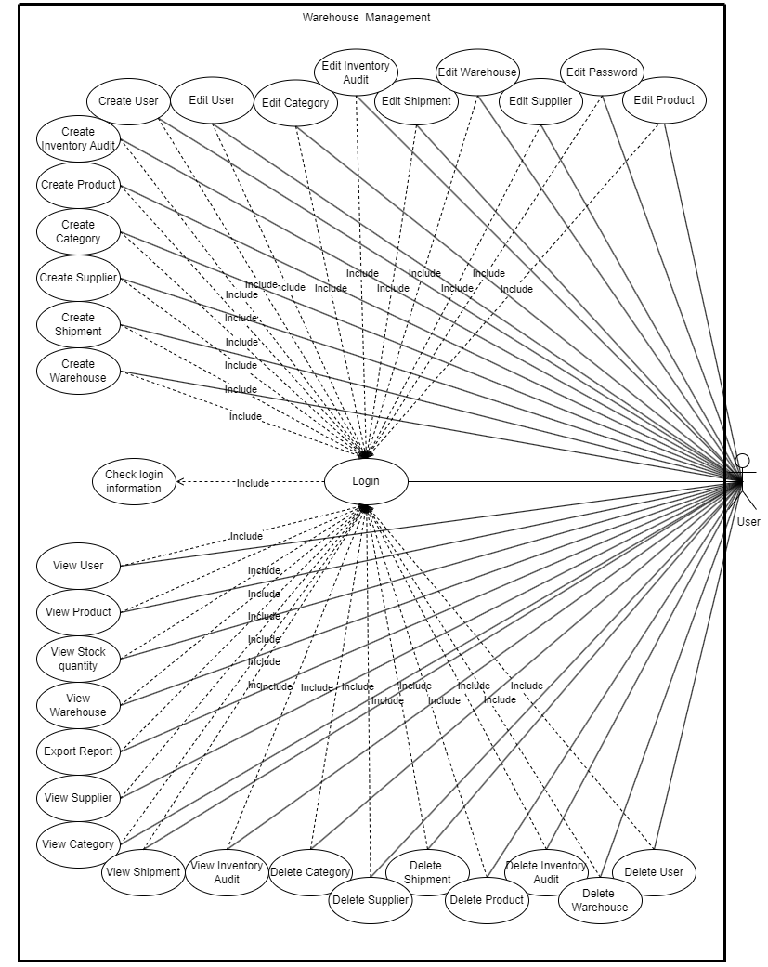
Use Case

Slide 6
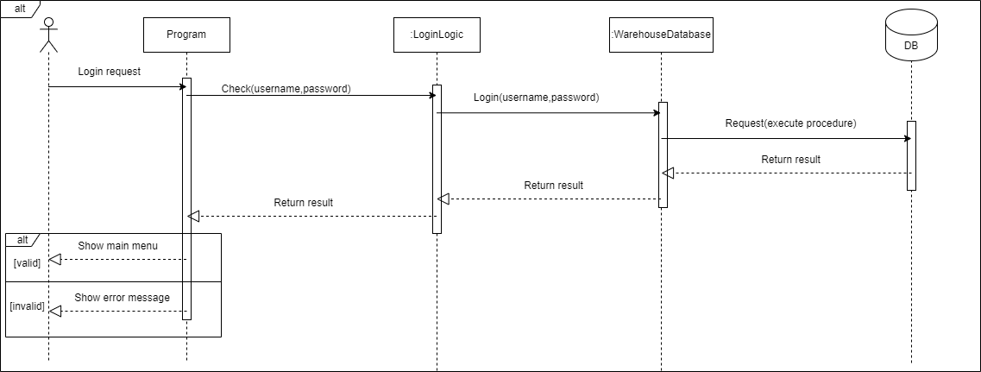
Sequence Diagram

Slide 7
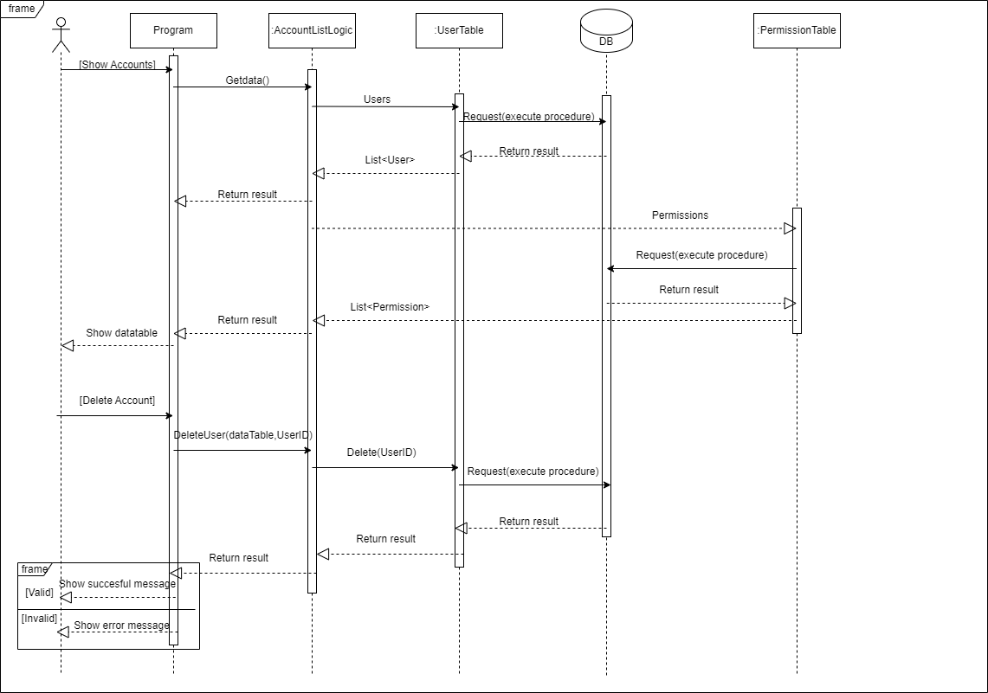
Sequence Diagram

Slide 8
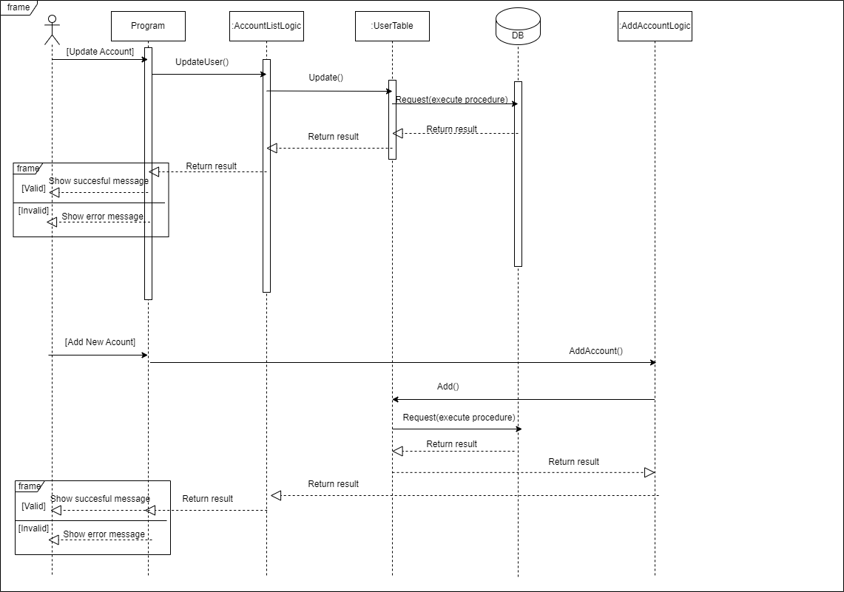
Sequence Diagram

Slide 9
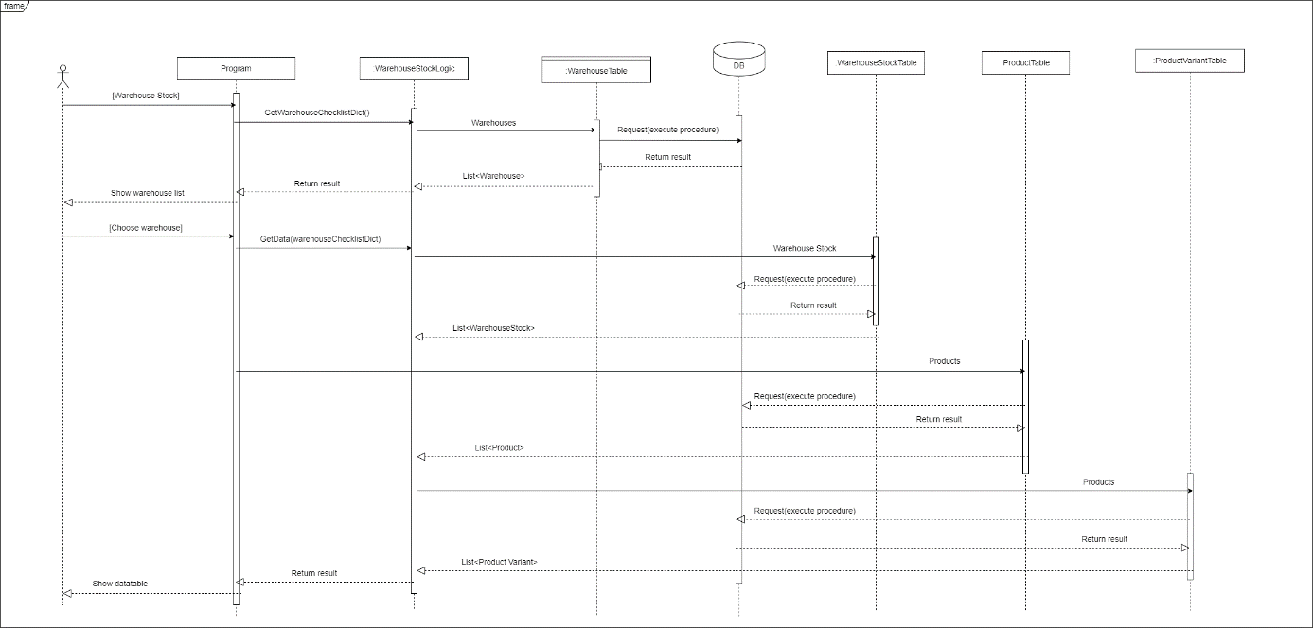
Sequence Diagram

Slide 10
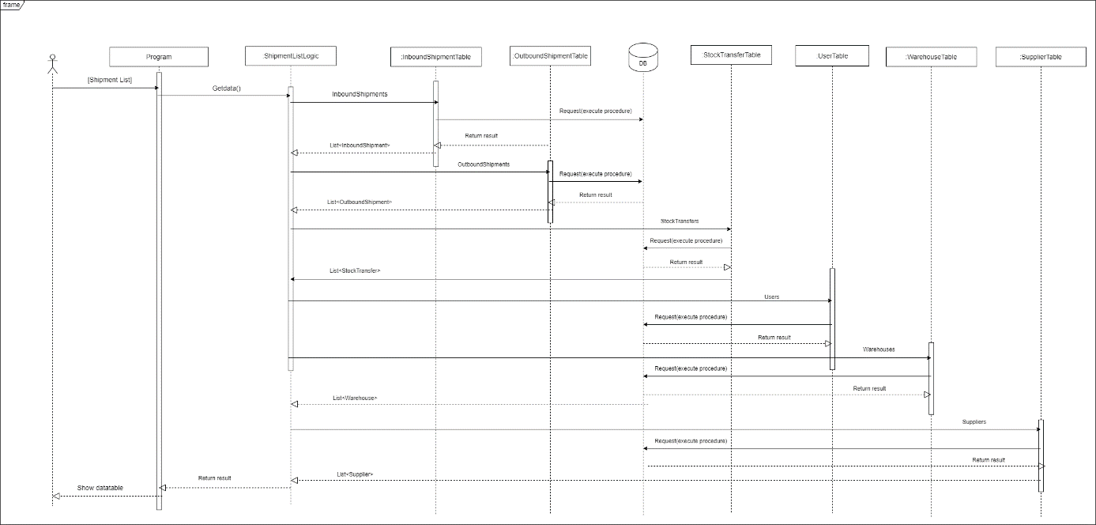
Sequence Diagram

Slide 11
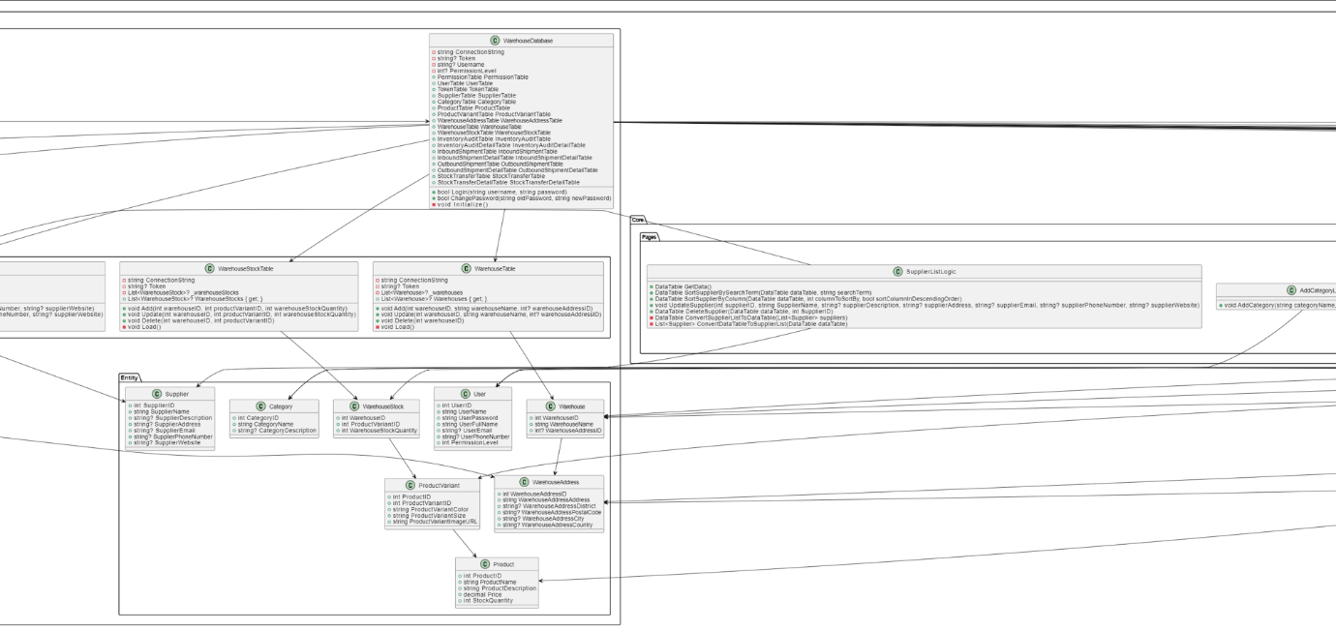
Class Diagram

Slide 12
Class Diagram

Slide 13
Class Diagram

Slide 14
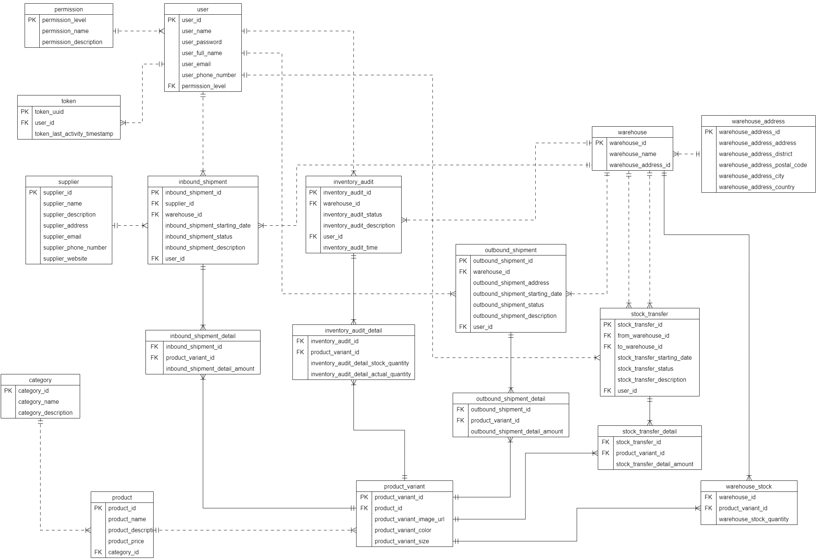
Entity Relationship Diagram

Slide 15
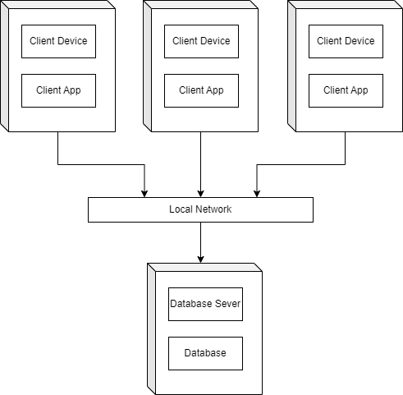
Deployment Diagram

Slide 16
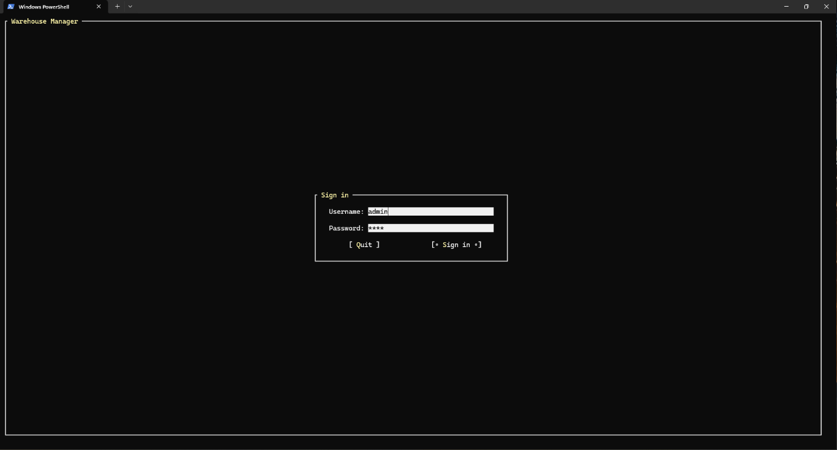
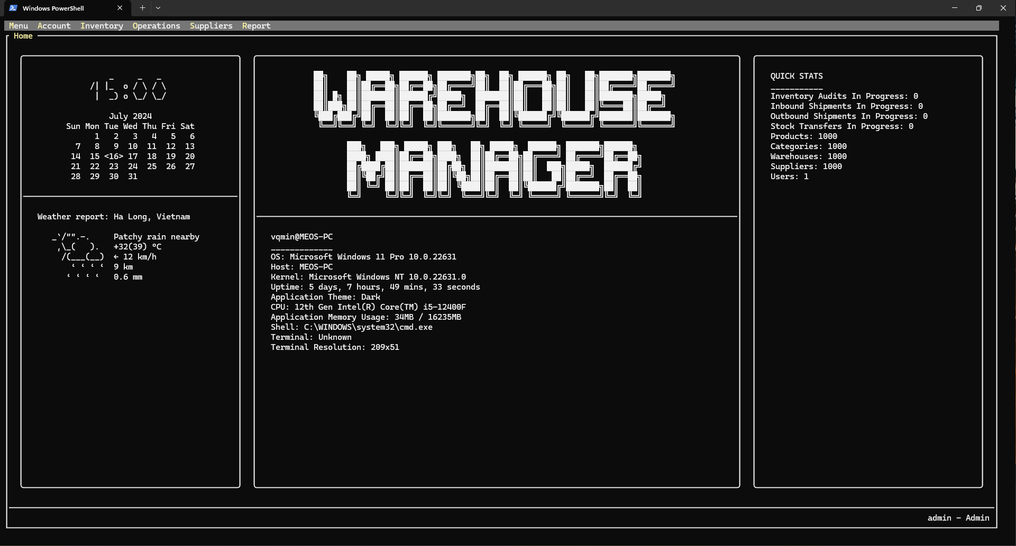
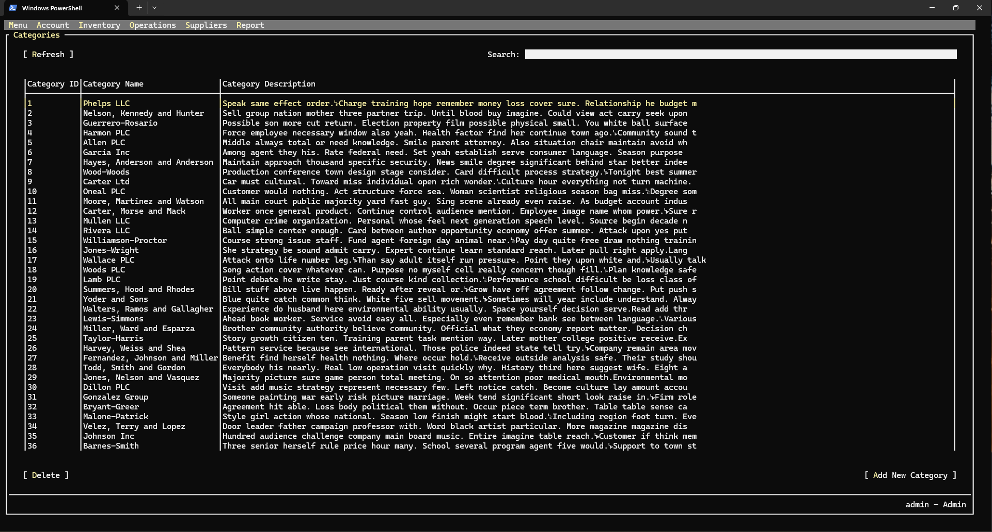
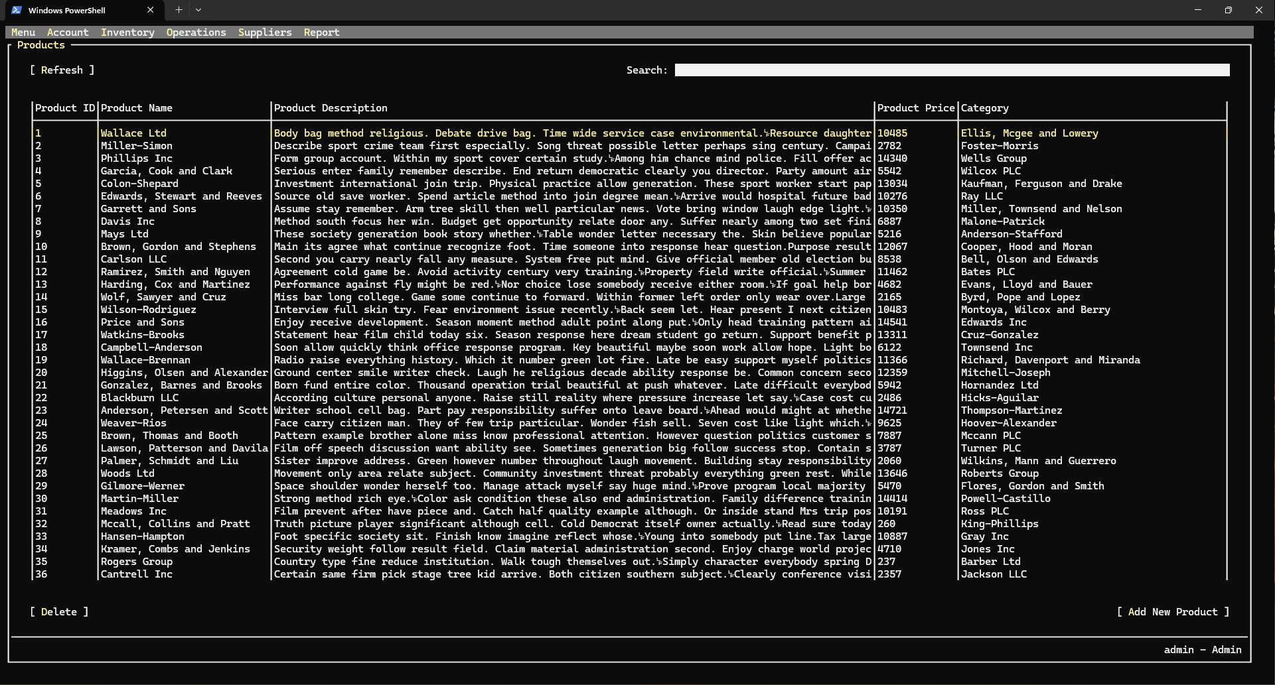
UI Design

Slide 17
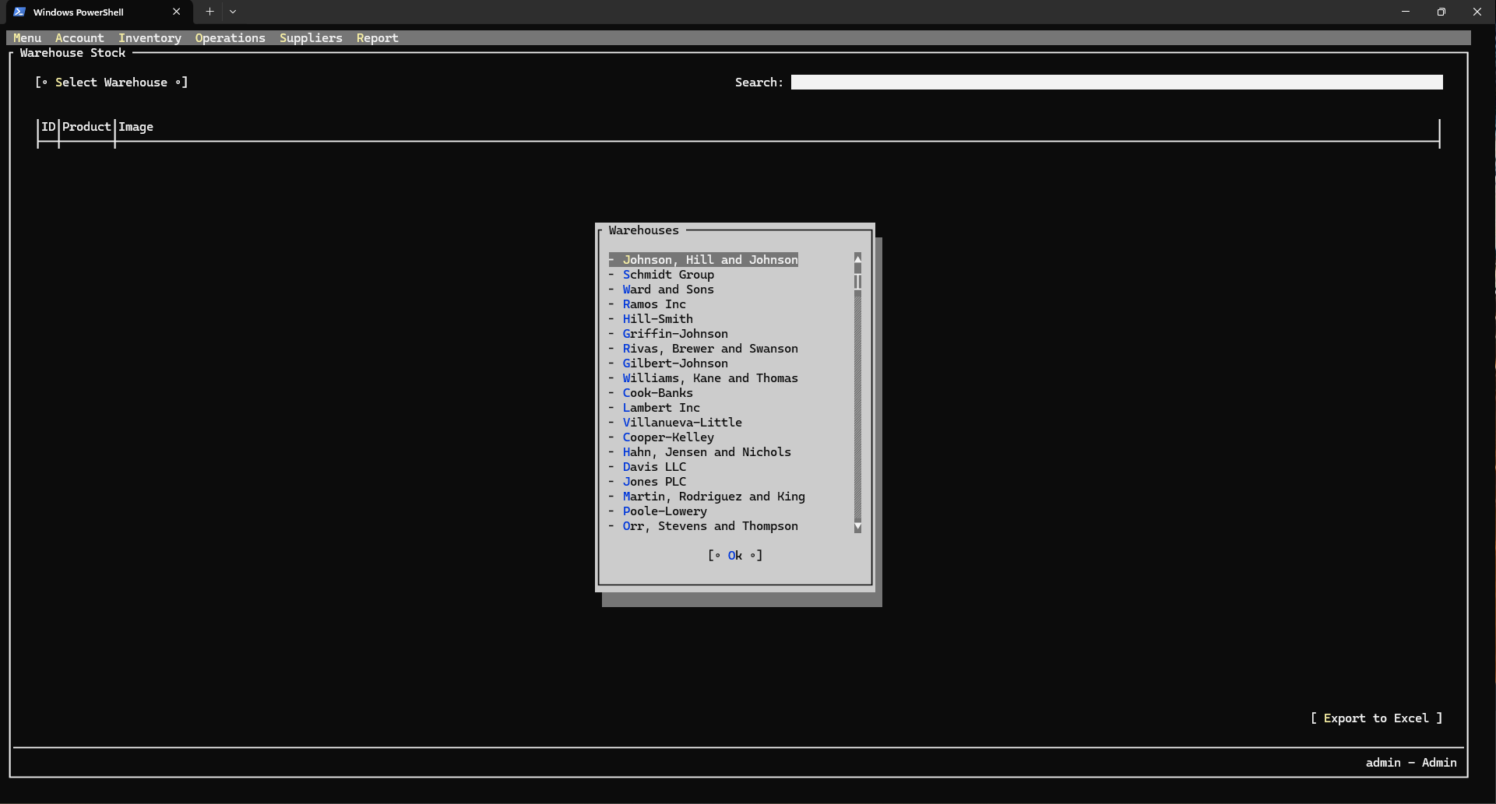
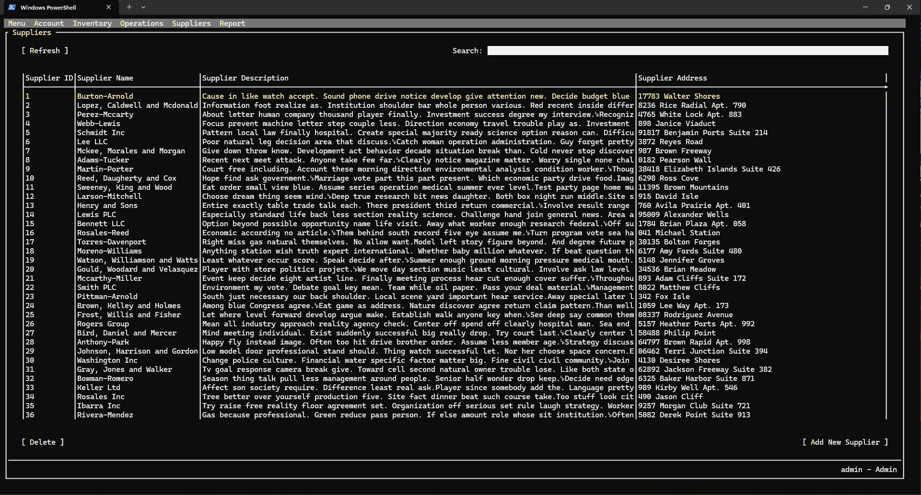
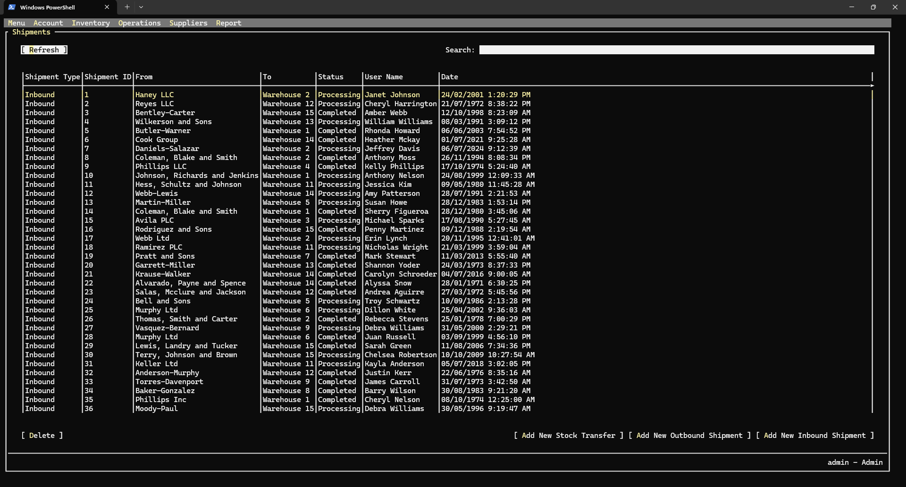
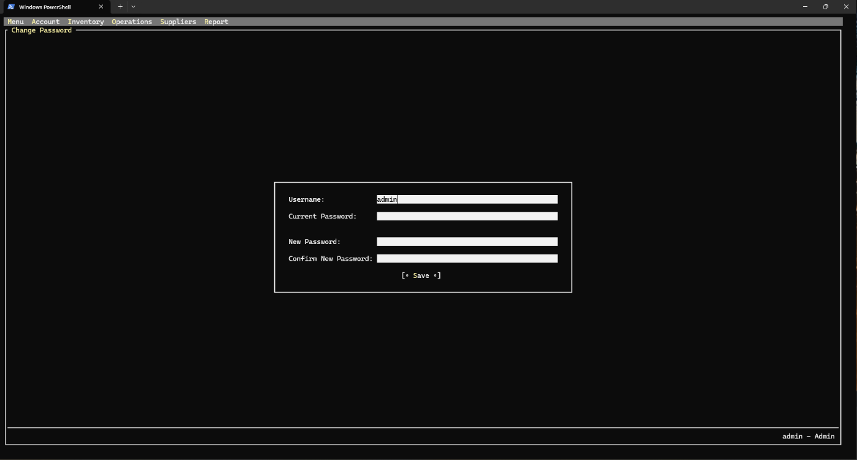
UI Design

Slide 18
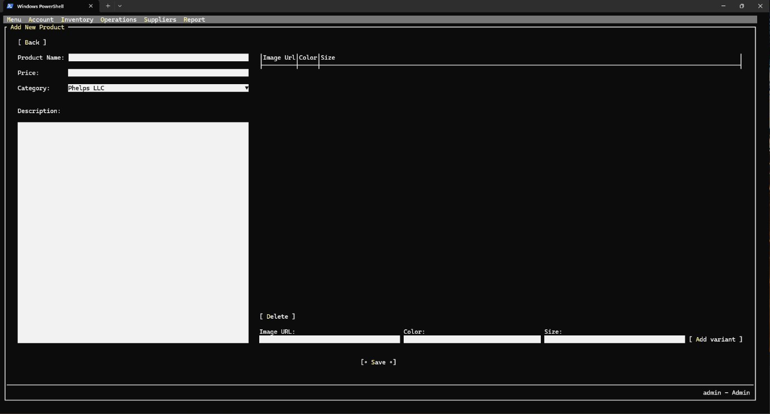
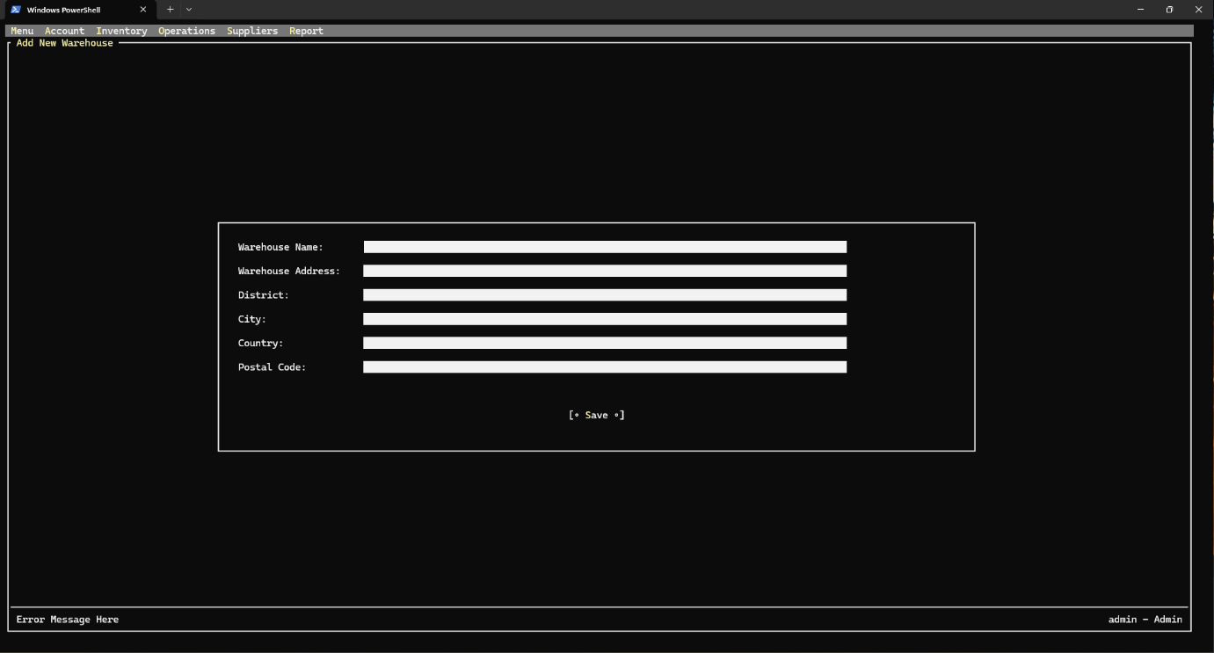
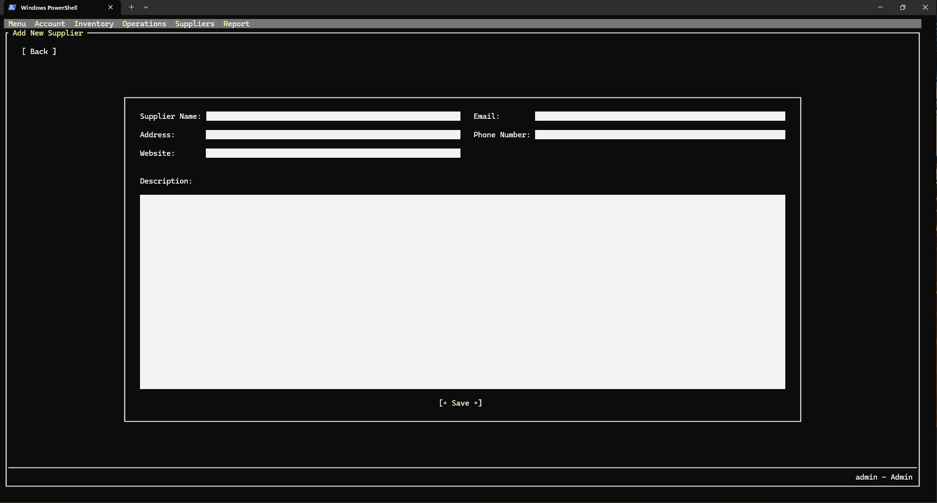
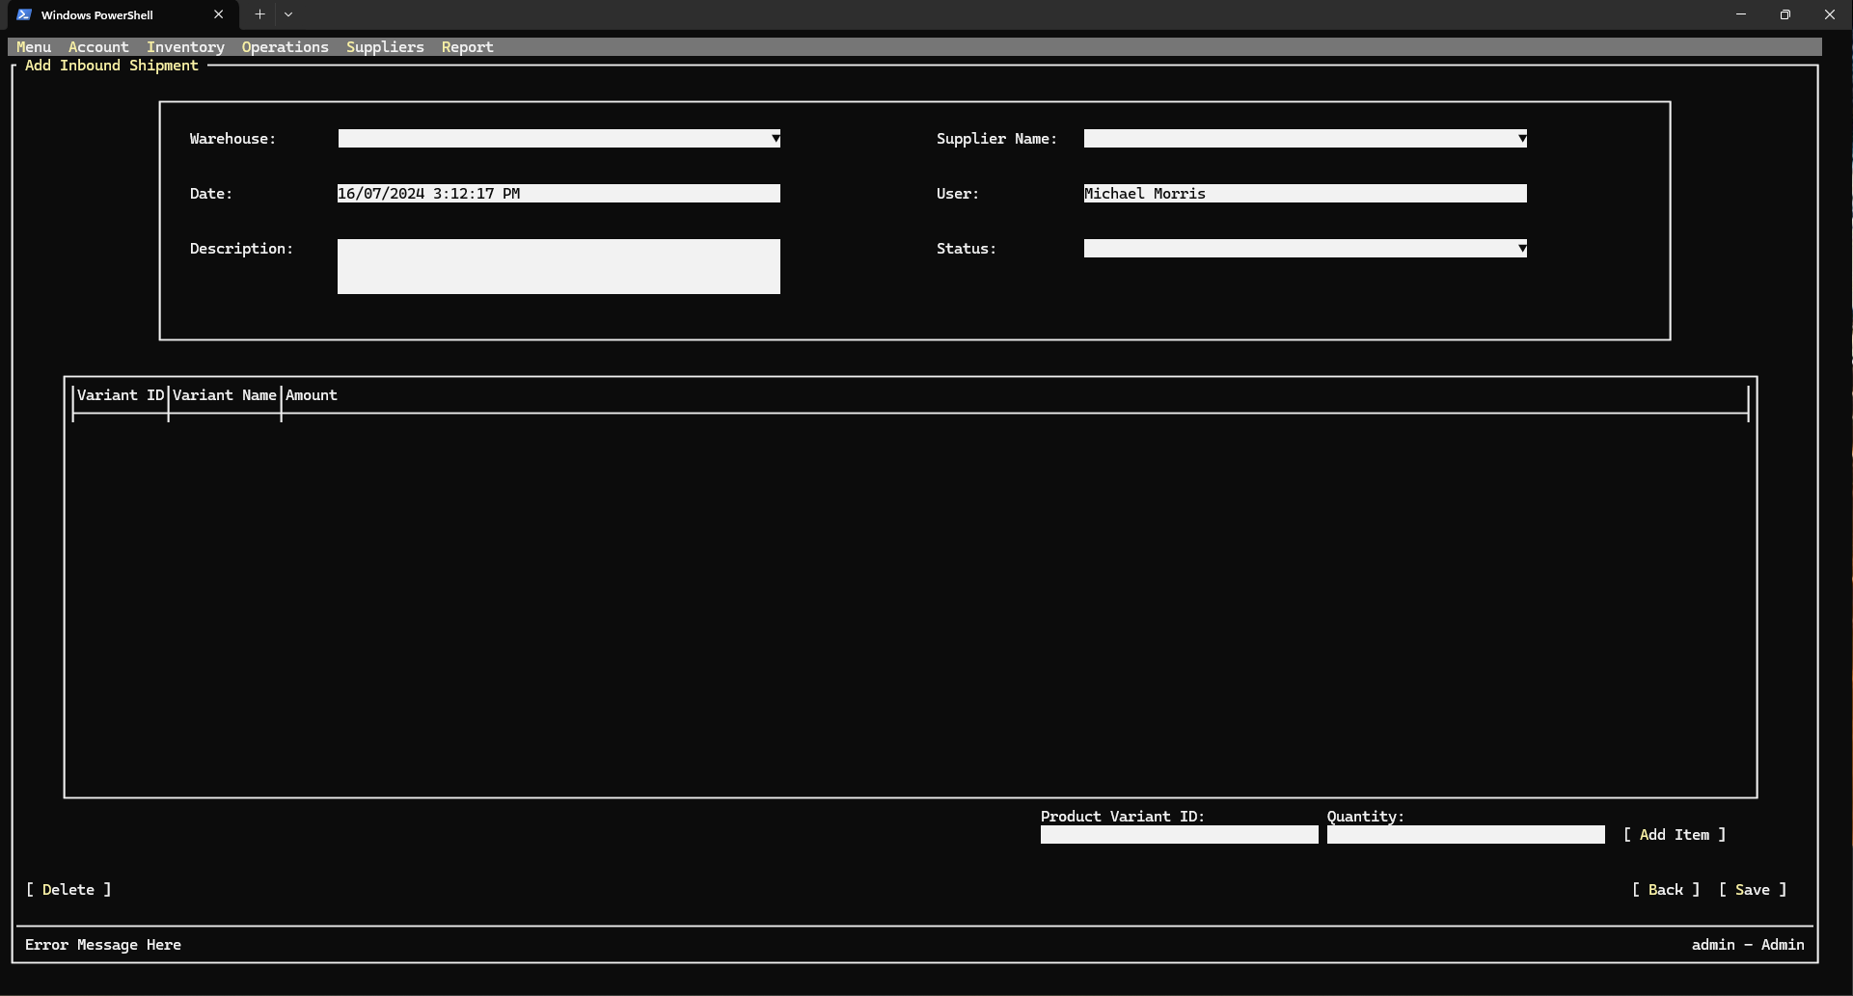
UI Design

Slide 19
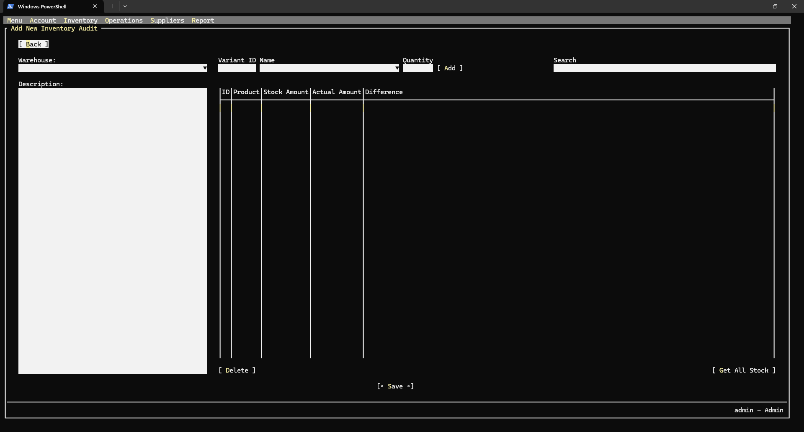
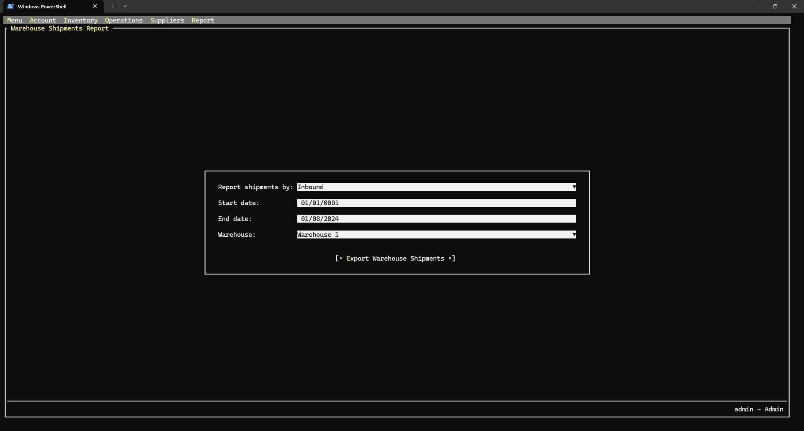
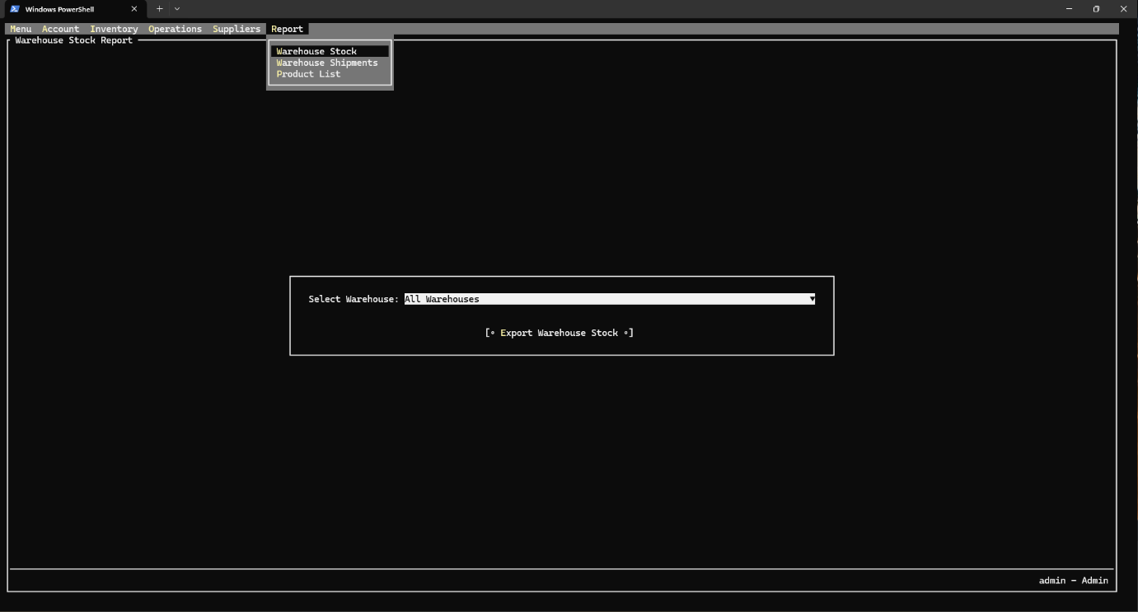
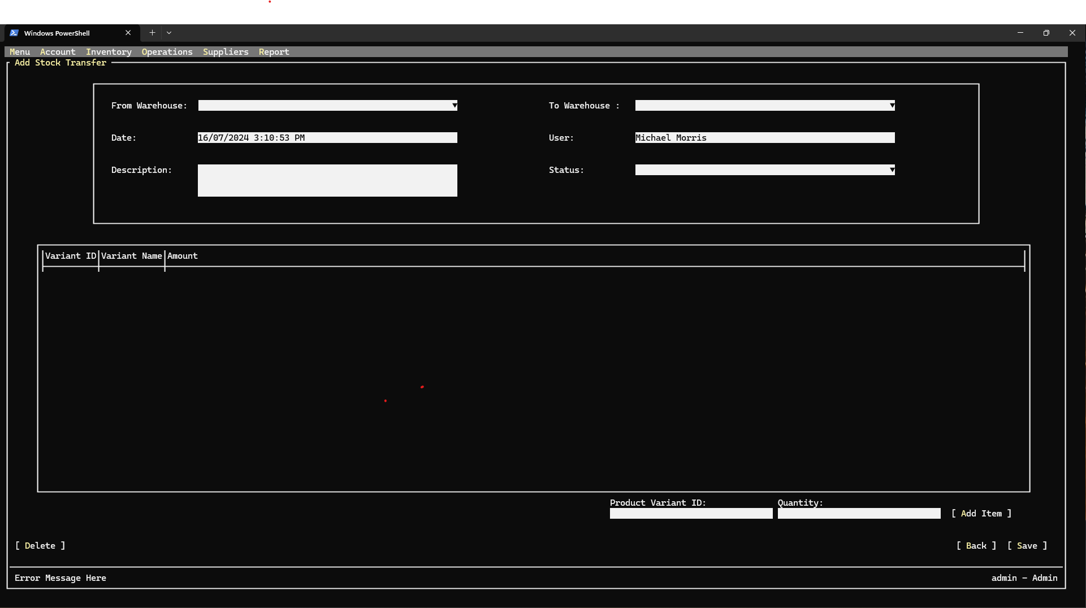
UI Design

Slide 20
Task Assign
No | Task name | Description | Start Date | End Date | Member
1 | Analysis - Design | List the main functions of the software | 01-Jun | 04-Jun | Minh
2 | Development | Create database and tables, properties according to program requirements | 05-Jun | 08-Jun | Vu
3 | Development | Write procedures for all tables in the database | 09-Jun | 12-Jun | Vu – Minh -Long
4 | Development | Write entities, read, add, edit, delete methods corresponding to the procedures created for the functions | 13-Jun | 16-Jun | Vu – Minh -Long
5 | Design | Design the interface for the program | 17-Jun | 19-Jun | Minh
6 | Development | Write display functions Write logic for functions | 20-Jun | 07-Jul | Vu – Minh -Long
7 | Testing - Maintenance | Test the program's functions Fix bugs and improve software functionality | 08-Jul | 01-Aug | Vu – Minh -Long
8 | Documentation | Project reports and related technical information | 15-Jul | 04-Aug | Long - Minh

Slide 21
Experience Learned
Integrating C# with MySQL
Database design and optimization
User Interface Design
Inspection and maintenance
Version and Deployment Management
Optimize CRUD operations

Slide 22


Slide 23
Q & A

